Slide 1

Class19
CSC 495/583 Topics of Software Security Format String Bug (2) & Heap
Dr. Si Chen (schen@wcupa.edu)

Slide 2
StackGuard
turn off stack guard
Insert Canary before the function being called.
Check this value to see if it been tweaked
Cowan, Crispan, et al. "Stackguard: automatic adaptive detection and prevention of buffer-overflow attacks." USENIX Security Symposium. Vol. 98. 1998.
https://www.usenix.org/legacy/publications/library/proceedings/sec98/full_papers/cowan/cowan.pdf

Slide 3
StackGuard: Stack Reading
Overflow one more byte and try every possible value
If no crash → success
Crash → wrong guess

Slide 4
Format String Bug

Slide 5
Format String Bug
What is a Format String?
A Format String is an ASCII string that contains text and format parameters
printf("%s %d\n", str, a);
fprintf(stderr, "%s %d\n", str, a); sprintf(buffer, "%s %d\n", str, a);
E.g.
My name is Chen

Slide 6
Format String Bug

Slide 7
Advanced Usage: Format String Direct Access

Slide 8
fmt_write.c
In C printf(), %n is a special format specifier which instead of printing something causes printf() to load the variable pointed by the corresponding argument with a value equal to the number of characters that have been printed by printf() before the occurrence of %n.

Slide 9
Write data in any memory address:
%n → DWORD
%hn → WORD
%hhn → BYTE

Slide 10
What is this BUG used for?
Read data in any memory address:
%s to read data in an arbitrary memory address
Write data in any memory address:
printf not only allows you to read but also write
%n

Slide 11
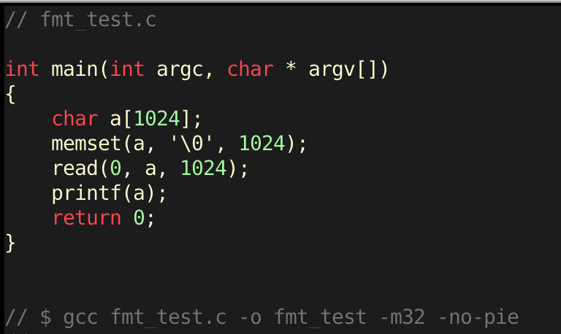
Exercise: fmt_test.c
Read data in any memory address:
%s to read data in an arbitrary memory address
Dump the whole program!

Slide 12
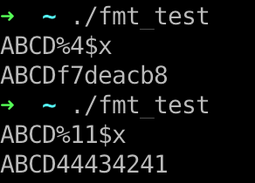
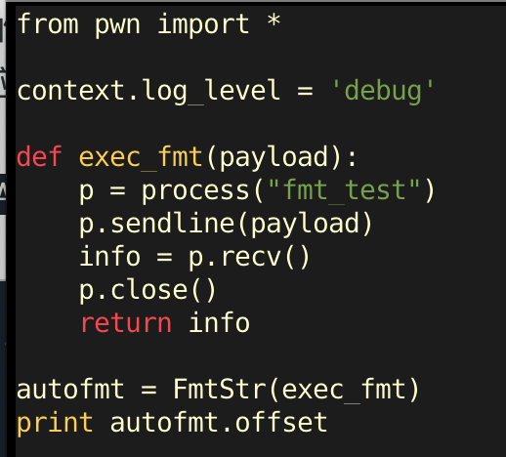
Find offset
Offset is 11

Slide 13
Leak Data
MemoryAddress%11$x
Data stored in that Memory Address
Address
Data
0xFFFFFFFF%11$x → 0xDEADBEEF
0xFFFFFFFF
0xDEADBEEF

Slide 14
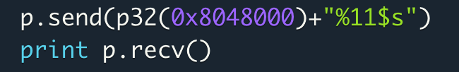
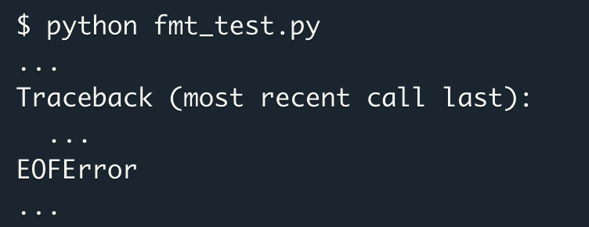
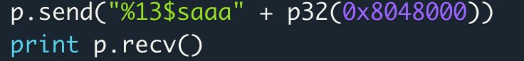
Another Issue
printf use \x00 to judge the end of the string
Solution: add some dummy characters to avoid truncate:

Slide 15
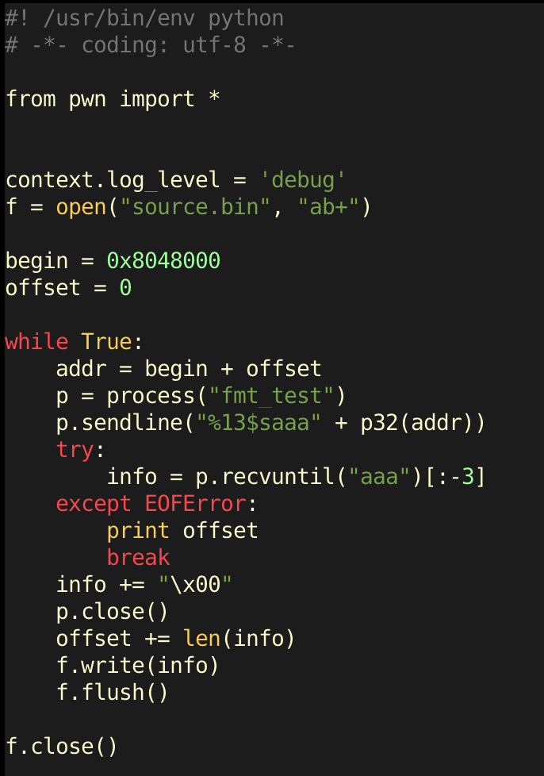
Dump the whole program!

Slide 16
What is this BUG used for?
Disclose sensitive information:
Variable(s)
EBP value
The correct location for putting Shellcode

Slide 17
What is this BUG used for?
Disclose StackGuard Canary:
By pass stack checking

Slide 18
What is this BUG used for?
Disclose Library Address
When enable ASLR, the library address will change each time
It’s impossible to call these functions in your shellcode (e.g. system())
Use this bug to disclose one function’s address in a given library.
you can use it to deduce other function’s address

Slide 19
What is this BUG used for?
Disclose Library Address
When enable ASLR, the library address will change each time
It’s impossible to call these functions in your shellcode (e.g. system())
Use this bug to disclose one function’s address in a given library.
you can use it to deduce other function’s address

Slide 20
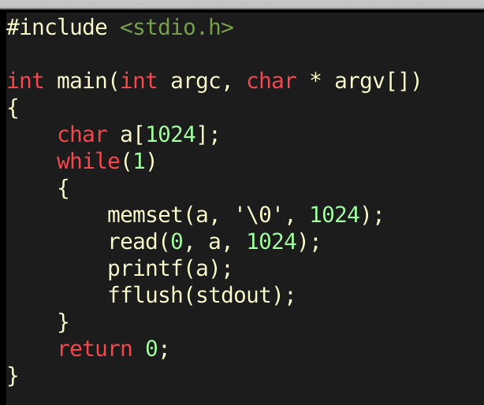
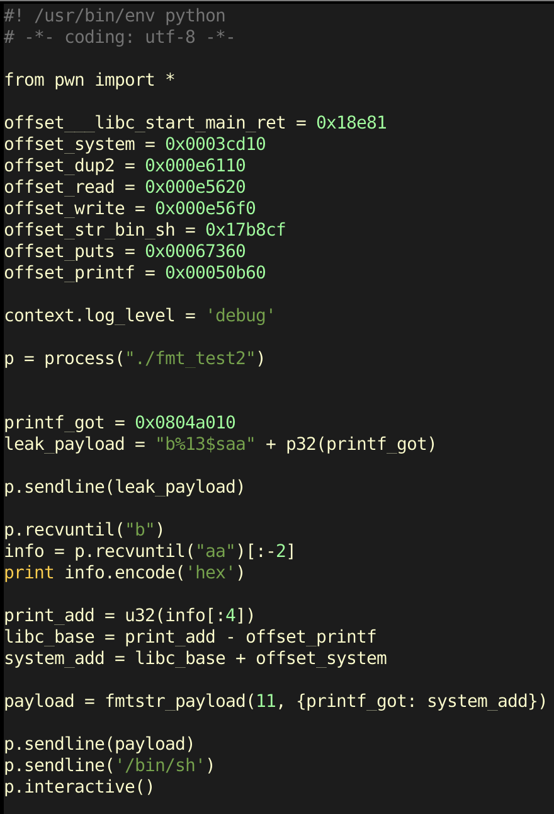
GOT Overwrite Attack with Format String Bug

Slide 21
The Heap

Slide 22
The Heap
Runtime Memory
Libraries (libc)
ELF Executable
.text segment
.data segment
Heap
Stack
0x00000000
It’s just another segment in runtime memory
0xFFFFFFFF

Slide 23
Basics of Dynamic Memory
int main()
{
char * buffer = NULL;
/* allocate a 0x100 byte buffer */ buffer = malloc(0x100);
/* read input and print it */ fgets(stdin, buffer, 0x100); printf(“Hello %s!\n”, buffer);
/* destroy our dynamically allocated buffer */ free(buffer);
return 0;
}

Slide 24
Heap vs Stack
Heap
Dynamic memory allocations at runtime
Objects, big buffers, structs, persistence, larger things
Slower, Manual
Done by the programmer
malloc/calloc/recalloc/free
new/delete
Stack
Fixed memory allocations known at compile time
Local variables, return addresses, function args
Fast, Automatic
Done by the compiler
Abstracts away any concept of allocating/de-allocating

Slide 25
malloc in glibc
ptmalloc

Slide 26
Heap Chunks
unsigned int * buffer = NULL; buffer = ptmalloc(0x100);
//Out comes a heap chunk
Heap Chunk
Previous Chunk Size (4 bytes)
Chunk Size (4 bytes)
Flags
Data
(8 + (n / 8)*8 bytes)
*(buffer-2)
*(buffer-1)
*buffer

Slide 27
Pseudo Memory Map
0x00000000 – Start of memory
0x00000000 – Start of memory
Runtime Memory
Libraries (libc)
ELF Executable
.text segment
.data segment
Heap
Stack
Runtime Memory
Libraries (libc)
ELF Executable
.text segment
.data segment
Heap
Stack
0x08048000 – Start of .text Segment
0x08048000 – Start of .text Segment
0xb7ff0000 – Top of heap
0xbfff0000 – Top of stack
0xFFFFFFFF – End of memory
MBE - 04/07/2015
27

Slide 28
Heap Allocations
0x00000000
Runtime Memory
Libraries (libc)
ELF Executable
.text segment
.data segment
Heap
Stack
Heap Segment
Grows towards higher memory
--------------------------------->
Previous Chunk Size
Chunk Size
Data
0xFFFFFFFF

Slide 29
Heap Allocations
0x00000000
Runtime Memory
Libraries (libc)
ELF Executable
.text segment
.data segment
Heap
Stack
Heap Segment
Grows towards higher memory
--------------------------------->
Previous Chunk Size
Chunk Size
Data
Previous Chunk Size
Chunk Size
Data
0xFFFFFFFF

Slide 30
Heap Allocations
0x00000000
Runtime Memory
Libraries (libc)
ELF Executable
.text segment
.data segment
Heap
Stack
Heap Segment
Grows towards higher memory
--------------------------------->
Previous Chunk Size
Chunk Size
Data
Previous Chunk Size
Chunk Size
Data
Previous Chunk Size
Chunk Size
Data
0xFFFFFFFF

Slide 31
Heap Chunks – In Use
Heap chunks exist in two states
in use (malloc’d)
free’d
Heap Chunk
Previous Chunk Size (4 bytes)
Chunk Size (4 bytes)
Flags
Data
(8 + (n / 8)*8 bytes)
*(buffer-2)
*(buffer-1)
*buffer

Slide 32
Heap Chunks – Freed
free(buffer);
Forward Pointer
A pointer to the next freed chunk
Backwards Pointer
A pointer to the previous freed chunk
Heap Chunk (freed)
Previous Chunk Size (4 bytes)
Chunk Size (4 bytes)
Flags
FD
(4 bytes)
BK
(4 bytes)
*(buffer-2)
*(buffer-1)
*buffer
*(buffer+1)

Slide 33
Heap Overflows
0x00000000
Runtime Memory
Libraries (libc)
ELF Executable
.text segment
.data segment
Heap
Stack
Heap Segment
Grows towards higher memory
--------------------------------->
Previous Chunk Size
Chunk Size
Data
Previous Chunk Size
Chunk Size
Data
Previous Chunk Size
Chunk Size
Data
0xFFFFFFFF

Slide 34
Heap Overflows
Buffer overflows are basically the same on the heap as they are on the stack
0x00000000
Runtime Memory
Libraries (libc)
ELF Executable
.text segment
.data segment
Heap
Stack
Heap Segment
Grows towards higher memory
--------------------------------->
Previous Chunk Size
Chunk Size
AAAAAAAAAAAAAA AAAAAAAAAAAAAA AAAAAAAAAAAAAA AAAAAAAAAAAAAA AAAAAAAAAAAAAA … heap overflow
Previous Chunk Size
Chunk Size
Data
Previous Chunk Size
Chunk Size
Data
0xFFFFFFFF

Slide 35
Heap Overflows
In the real world, lots of cool and complex things like objects/structs end up on the heap
Anything that handles the data you just corrupted is now viable attack surface in the application
It’s common to put function pointers in structs which generally are malloc’d on the heap
Overwrite a function pointer on the heap, and force a codepath to call that object’s function!

Slide 36
Q & A

